Slide 1

Intro to GitHub Workshop
The Enthusiastic Programmers Club

Slide 2

What We will Go Over
Why Github, Git? Why is it so popular?
Brief History of Git (What operates GitHub Differences)
How to Navigate http://www.github.com
Using the Desktop GitHub Client
Wrap up Short Q&A

Slide 3

GitHub? Social Coding, What is all the BUZZ about?
Popular tool in the software developer community.
HR looks at your GitHub Profile.
Very useful tool to track bugs, collaborate on massive projects with a group of people.
Clone massive software projects.
Anyone can read your source code if you make it public.
Great way to connect among developers online.

Slide 4

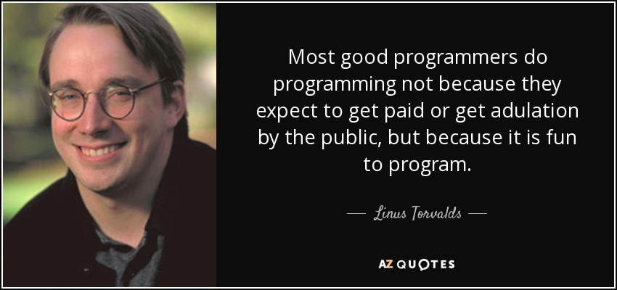
Git A Brief History
Created by Linus Torvalds The development of Git began on 3 April 2005.
Linus Torvalds is inventor of the popular Linux OS kernel in 1991.
Created because Bit Keeper a popular source control management tool wasn’t open source.
Didn’t favor to Torvalds, tried to reverse engineer it but made his own Distributed Version Control instead and made it Open Source (Meaning anyone could take a look at the source code).

Slide 5
Git vs Github
Git: is a Version Control System for tracking files in a computer System and Coordinating work among other people. (https://en.wikipedia.org/wiki/Git)
GitHub: is a web-based Git or version control repository and Internet hosting service. It offers all of the distributed version control and source code management (SCM) functionality of Git as well as adding its own features. (https://en.wikipedia.org/wiki/GitHub)
TLDR: Git is software for tracking, collaborating. Github hosts that software for people.

Slide 6
A Little more background on GitHub
Website where Git System system is ran for million of users
Your Source Code is stored in a database known as ‘Repositories.’
Multiple Dedicated Servers or Nodes serve your content on the fly
Organizations like NASA (https://github.com/nasa) and major software development teams use this tool to share & Collaborate on code.
Linus Torvalds has himself hosted the Linux kernel source tree on GitHub. And he works very actively on it. @torvalds/linux

Slide 7
Navigating Github.com
Go to http://www.github.com on your favorite web browser (cough Firefox).
Create an account, you can use your my.vcccd.edu email.

Slide 8
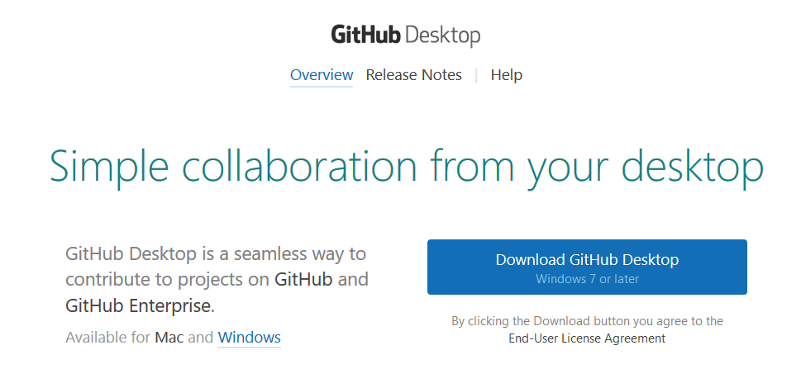
Download the GitHub Client
Go to
http://www.desktop.github.com
and press the blue download button, run it & let it download.

Slide 9

Q&A
Have any questions about Git or GitHub?
Source: https://lh3.googleusercontent.com/-aC-iH_xS5tY/VSPsVXBWbmI/AAAAAAAANVI/Al9MkYz8VQY/w1930-h1090/git-fork-you.jpg

